Slide 1
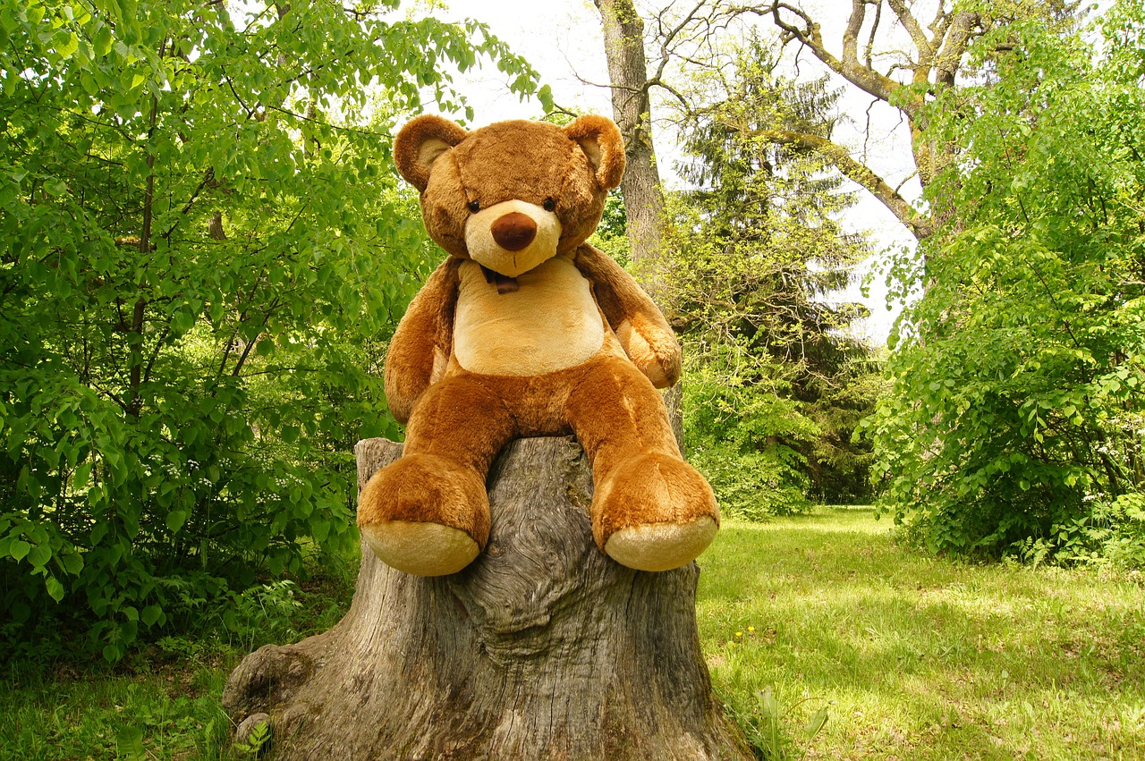
As we can no longer have our special day in Nursery all together here is a home learning task; Plan and Prepare a Teddy Bears Picnic
Design and write invitations with your child, encourage them to use their creative skills to design them. Support them to make up the wording and write the invitations themselves – they may be keen to copy your writing.
Prepare the food with your child – discuss handwashing and why this is always important.
Make a plan with your child of what you need to gather & do- encourage your child to draw or write the plan.
Can you find out what wild bears eat?
Click on the link to hear and sing along to Teddy Bear Picnic | Children Songs | Rhymes Songs | The ...
Make a menu, discuss healthy and treat options
Take a photo or draw a picture with your child and share it with us
Can you find out where bears live?
Click the link to watch the Story “We’re Going on a Bear Hunt” by Michael Rosen
Michael Rosen performs We're Going on a Bear Hunt - YouTube
Enjoy sharing the picnic with your child and their ‘guests’.
Share your adventures with us @BilstonPrimary #BilstonELC and bilston.ps@midlothian.gov.uk

