Slide 1
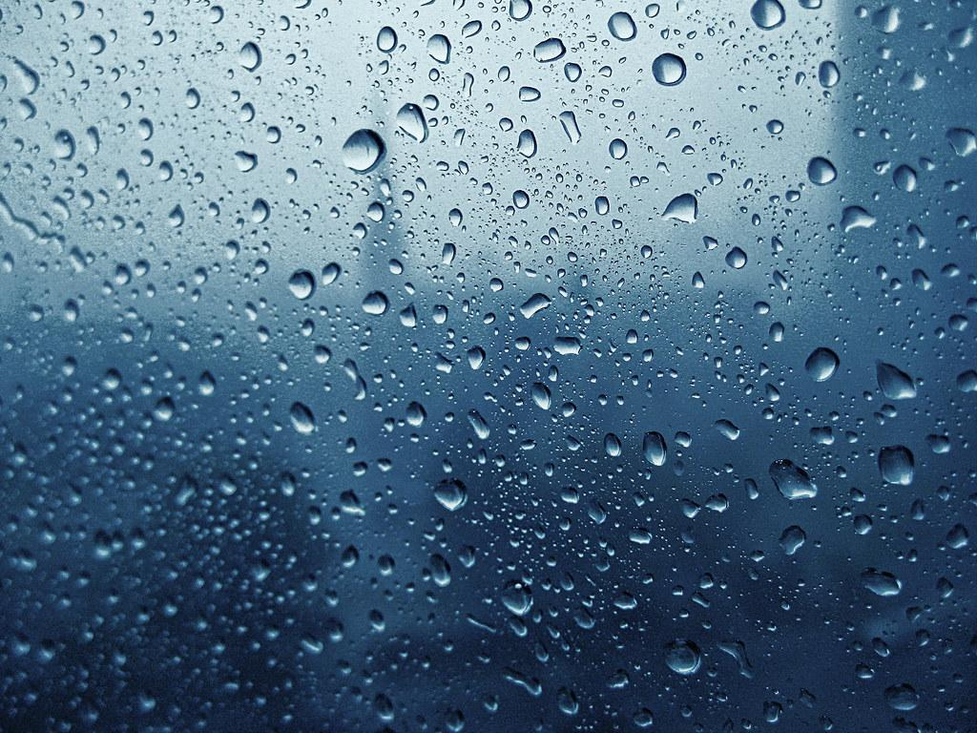
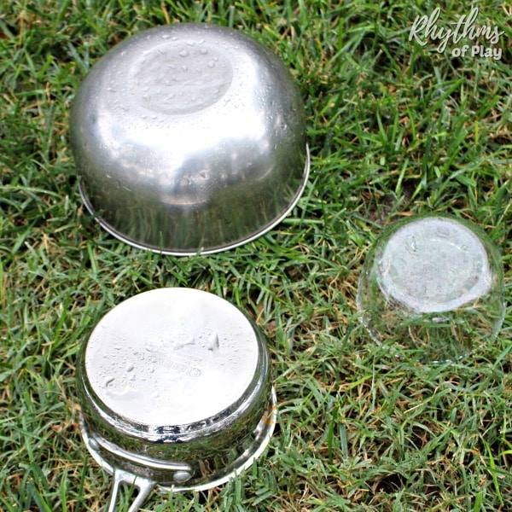
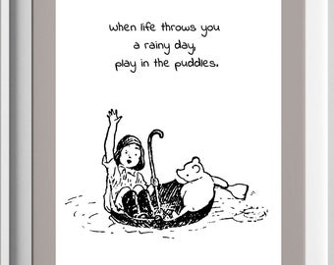
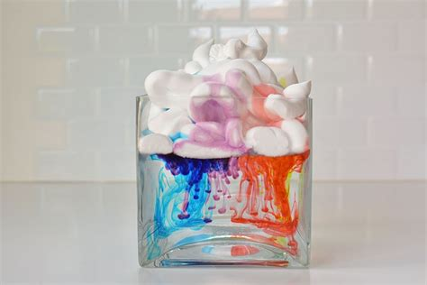
Rain
Making Rain music
Can you put out pots, pans, bowls, tins, or anything else you think might make a nice sound when raindrops fall on them. Talk about the noises you hear can you hear a tip, tap, ting? Or, create the sound of rain with a DIY rainstick made from recycled and naturally sourced materials. Click the link to learn how to make your own see-through rainstick.
Can you sing and dance in the rain? Follow the link to listen to a rain song Singing in the Rain Song Original Kids Version Kid ... - YouTube
Over the next few days the weather is forecast Rain. Here are some fun activities you could try outdoors in your gardens in the rain.
Can you make some Rain Art?
Use pens to draw on paper, then put your drawings out in the rain to watch what happens. Discuss new patterns, shapes etc as they appear.
The children in nursery particularly enjoy carrying out science experiments. Why not make your own rain cloud in a jar. Find the instructions here Rain Cloud in a Jar - The Stem Laboratory
Do you know how Rain is formed? Why not follow the link to watch a short clip that will help you learn about the water cycle The Water Cycle- How rain is formed-Lesson for kids - YouTube Can you draw your own water cycle?
Share your adventures with us @BilstonPrimary #BilstonELC and bilston.ps@midlothian.gov.uk

