Slide 1
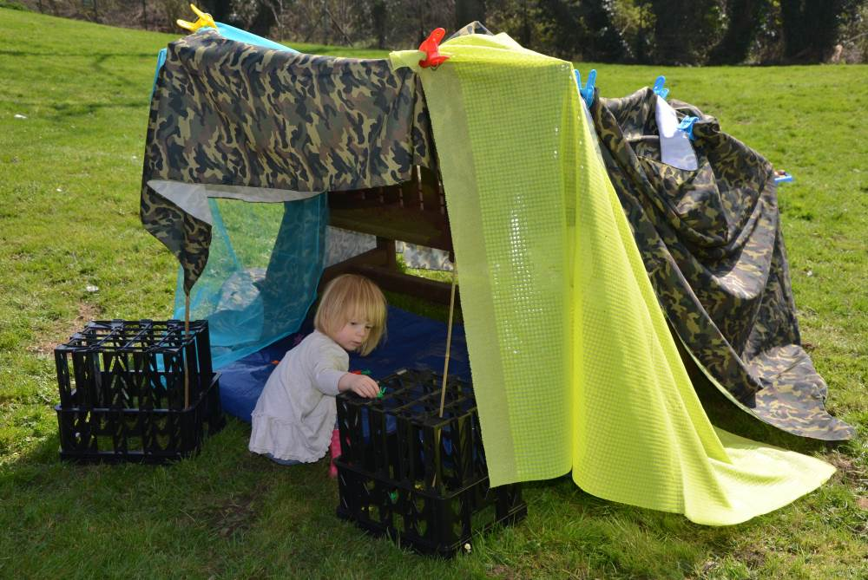
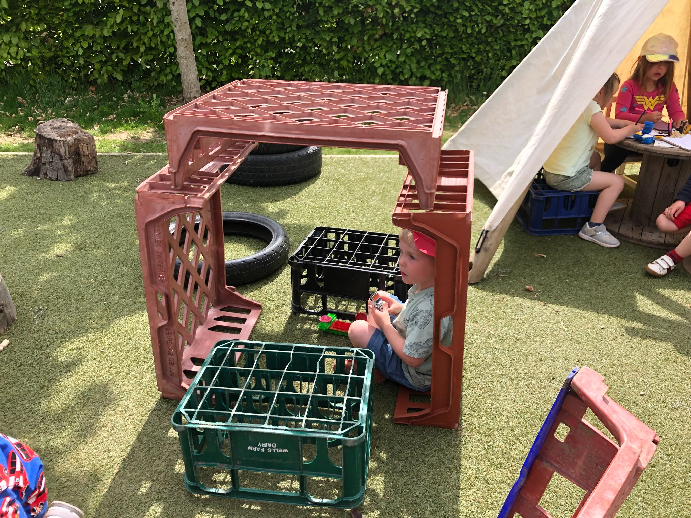
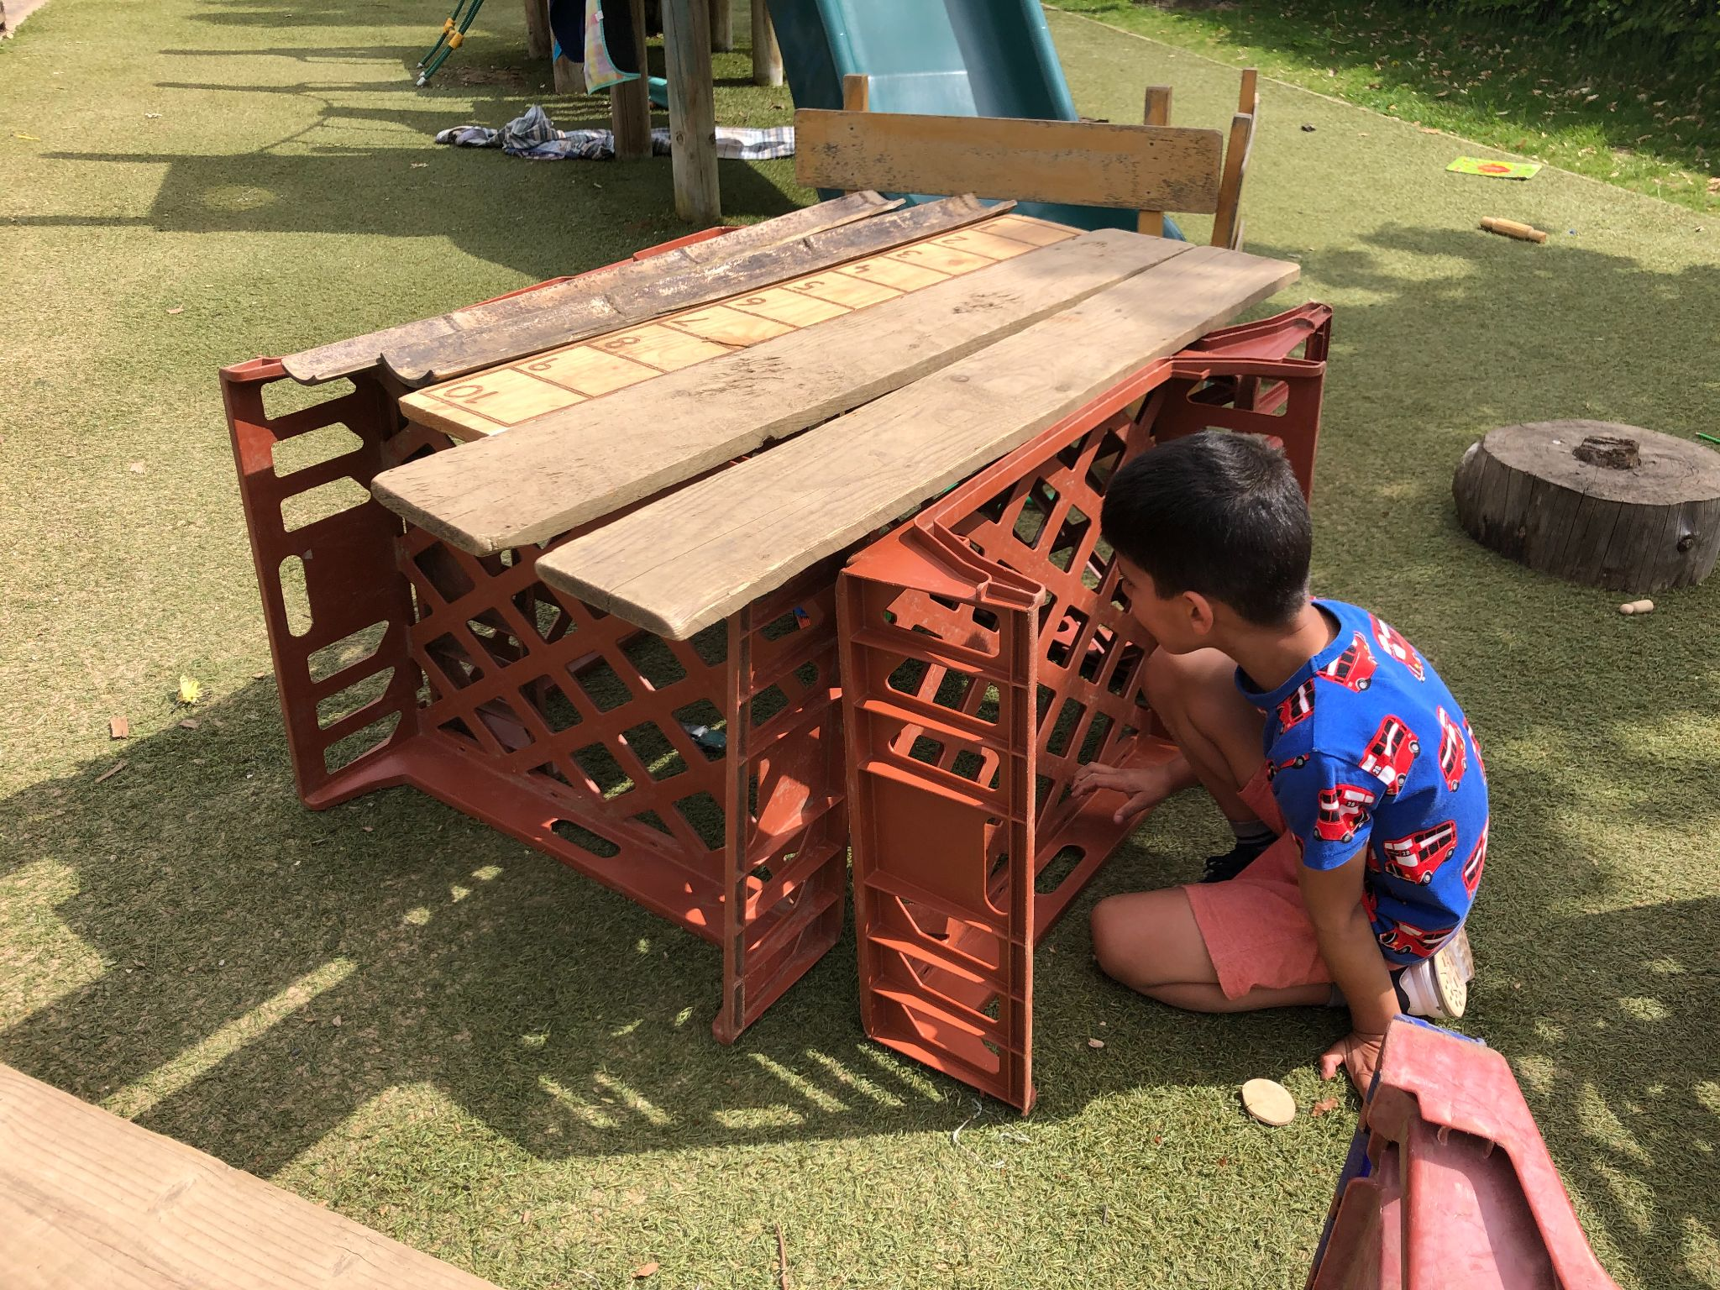
Den building with loose parts, blankets etc, has been a very popular activity this term. Your task is to search around your house/garden and find items to construct your own den or tent.
Can you can make it big enough for you and some of your toys or cuddlies to fit inside.
Challenge
Listen to the classic fairy tale - “The 3 Little Pigs” by clicking this linkThree Little Pigs ( 3 Little Pigs ) | Bedtime Stories for Kids - YouTube
Ideas for resources; blankets,chairs boxes,cushions, crates, sticks, branches,rope, string...
Can you draw a plan first? How will you balance the items? Do you need a door or windows?
We are really keen to see your creations and add them to your learning profiles… Please share your experiences with us at;
bilston.ps@midlothian.gov.uk

