Slide 1
Guide to using Google Classroom on an PC or Chromebook
All you need to access Google Classroom on these devices is a web browser – Chrome Browser works best as it is also made by Google.

Slide 2
Sign into Glow using a web browser

Slide 3
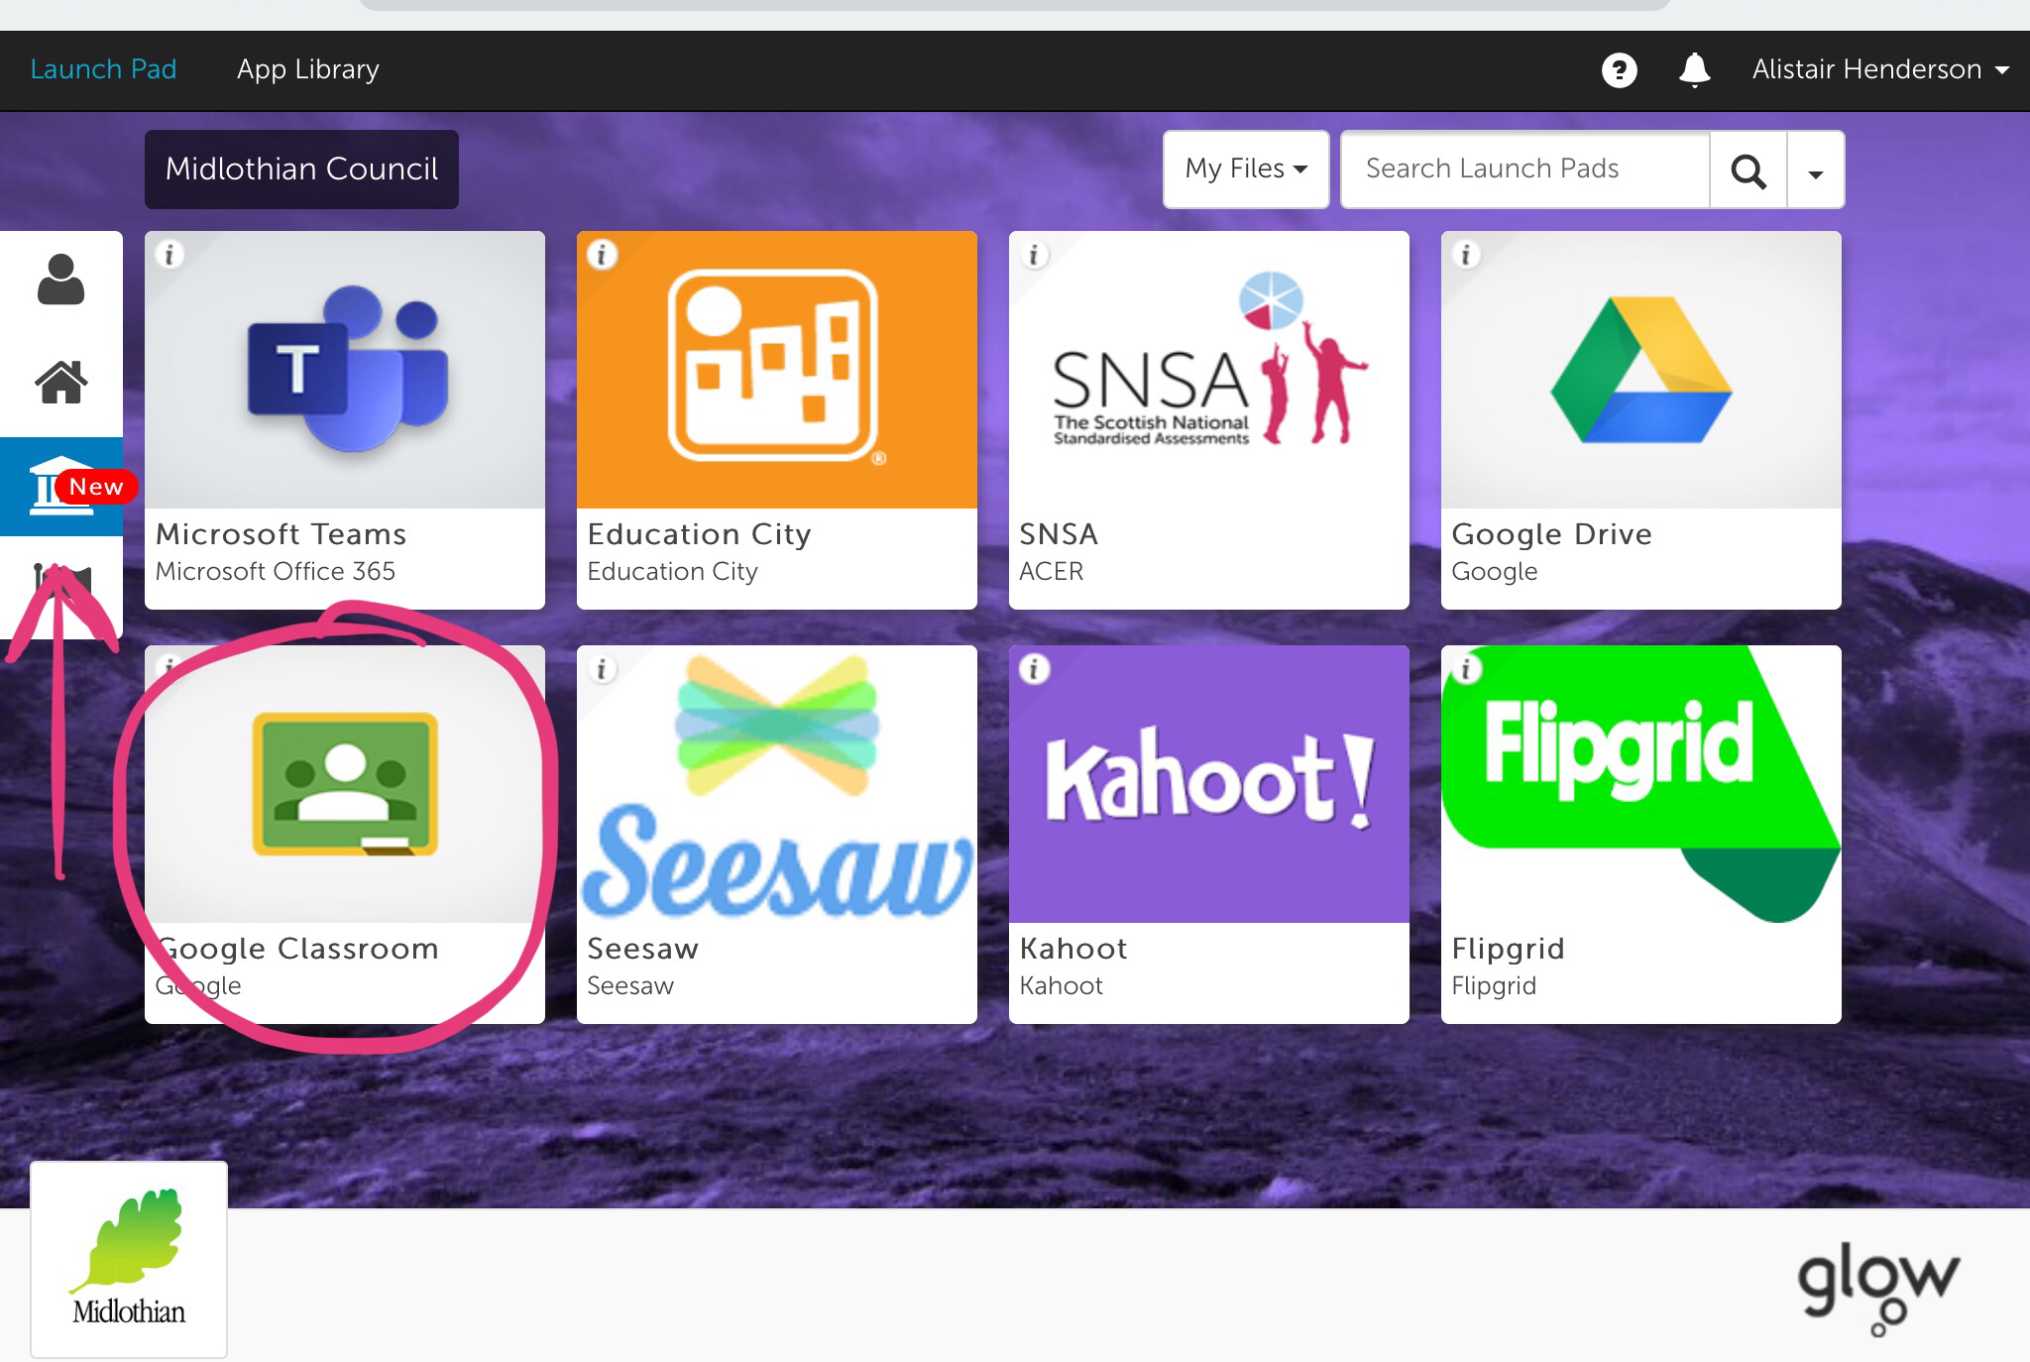
Then choose the Google Classroom tile. If you can’t see it, look on the Midlothian Council tab on the left.

Slide 4
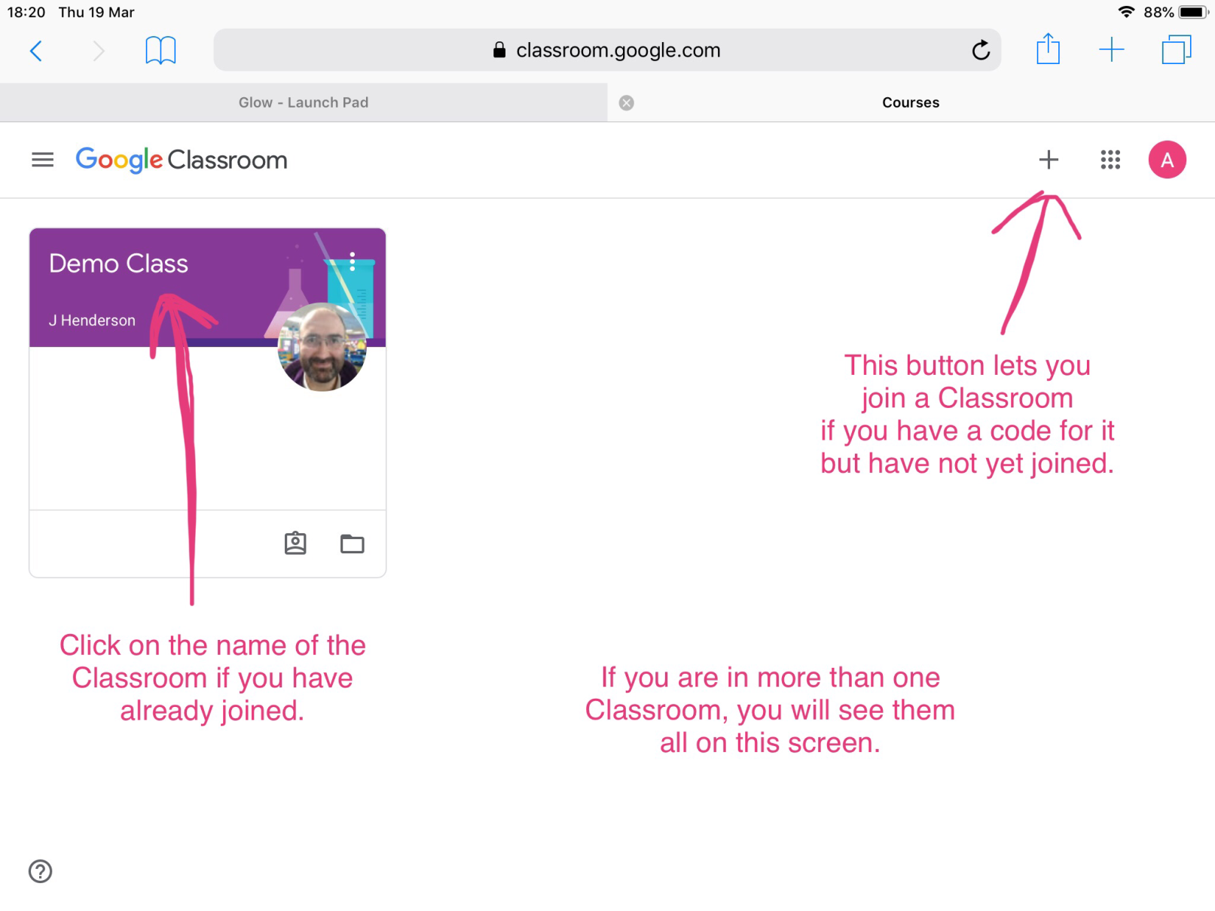
Next, choose your Classroom.

Slide 5
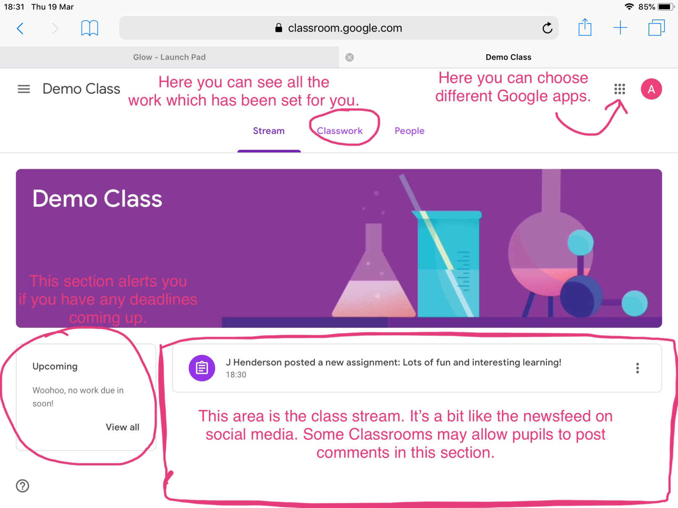
When you are in your Classroom it will look something like this.

Slide 6
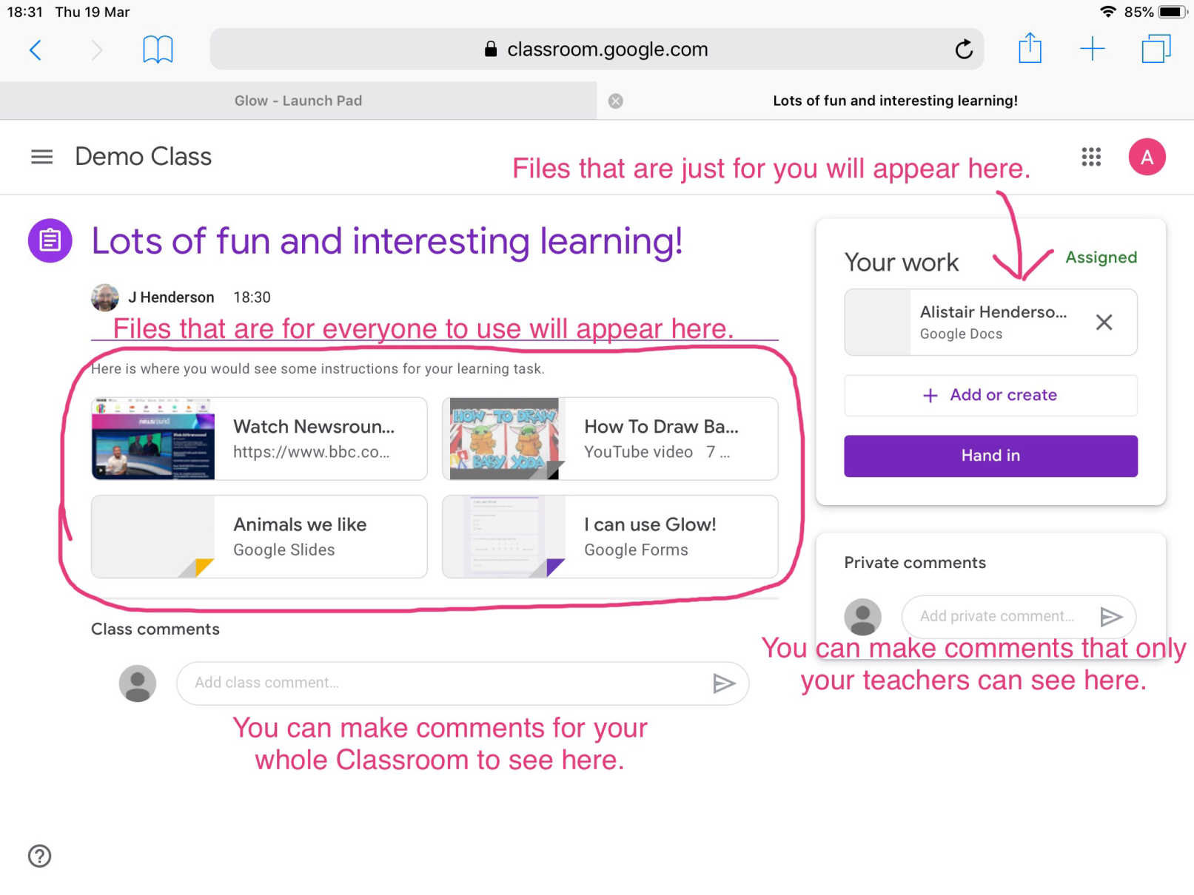
When you click on an assignment, you will see a screen like this one.
All the links and files will open in new browser tabs.

Slide 7
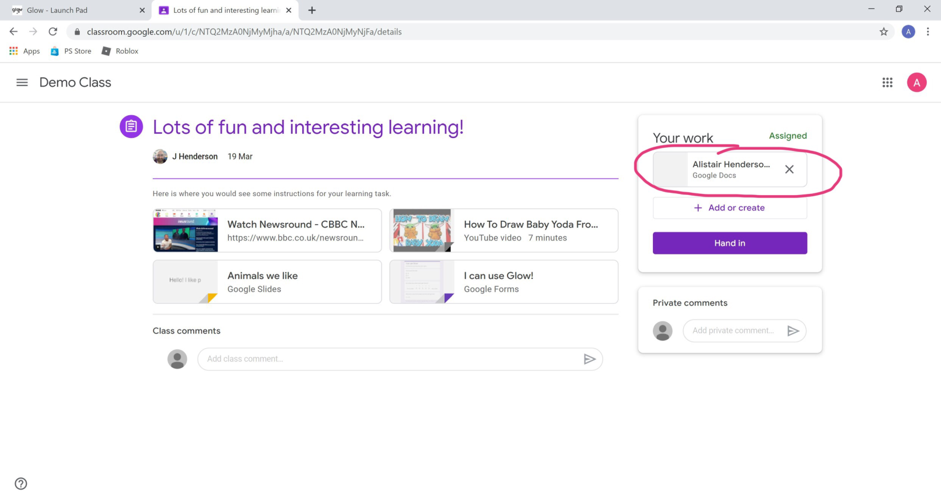
To work on your individual document, click here.
Docs will open in a new browser tab.

Slide 8
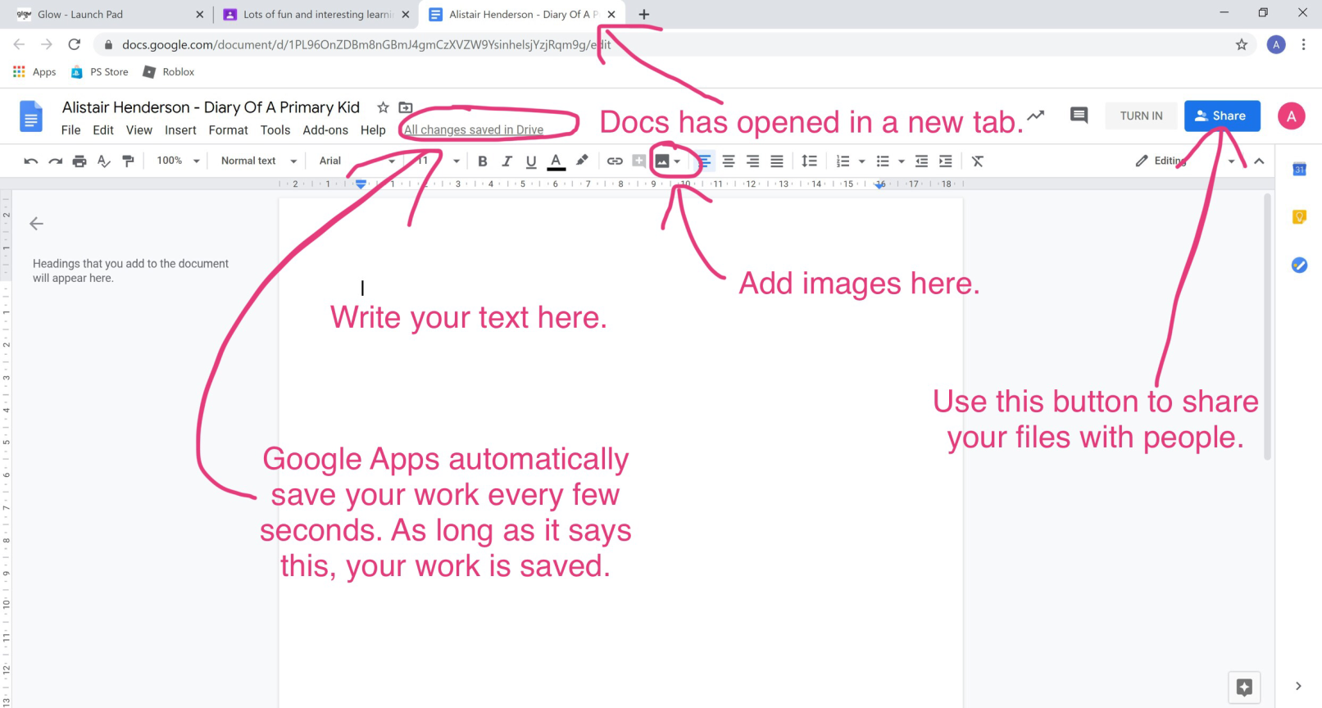
All of Google’s apps will look familiar to anyone who has used Office.

Slide 9
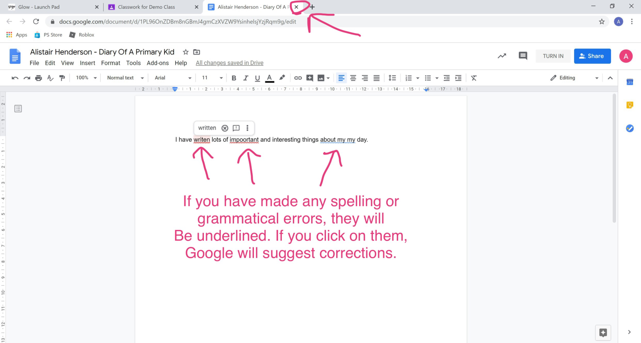
Google Apps save every few seconds so once
you have made any corrections, simply close the tab by clicking the ‘x’ indicated.

Slide 10
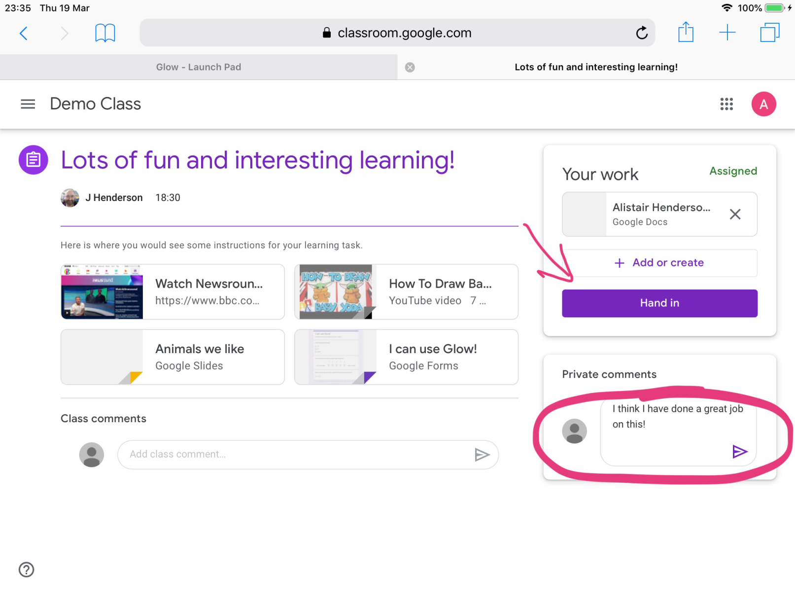
Then you can add a comment if you like and hand in your work.

Slide 11
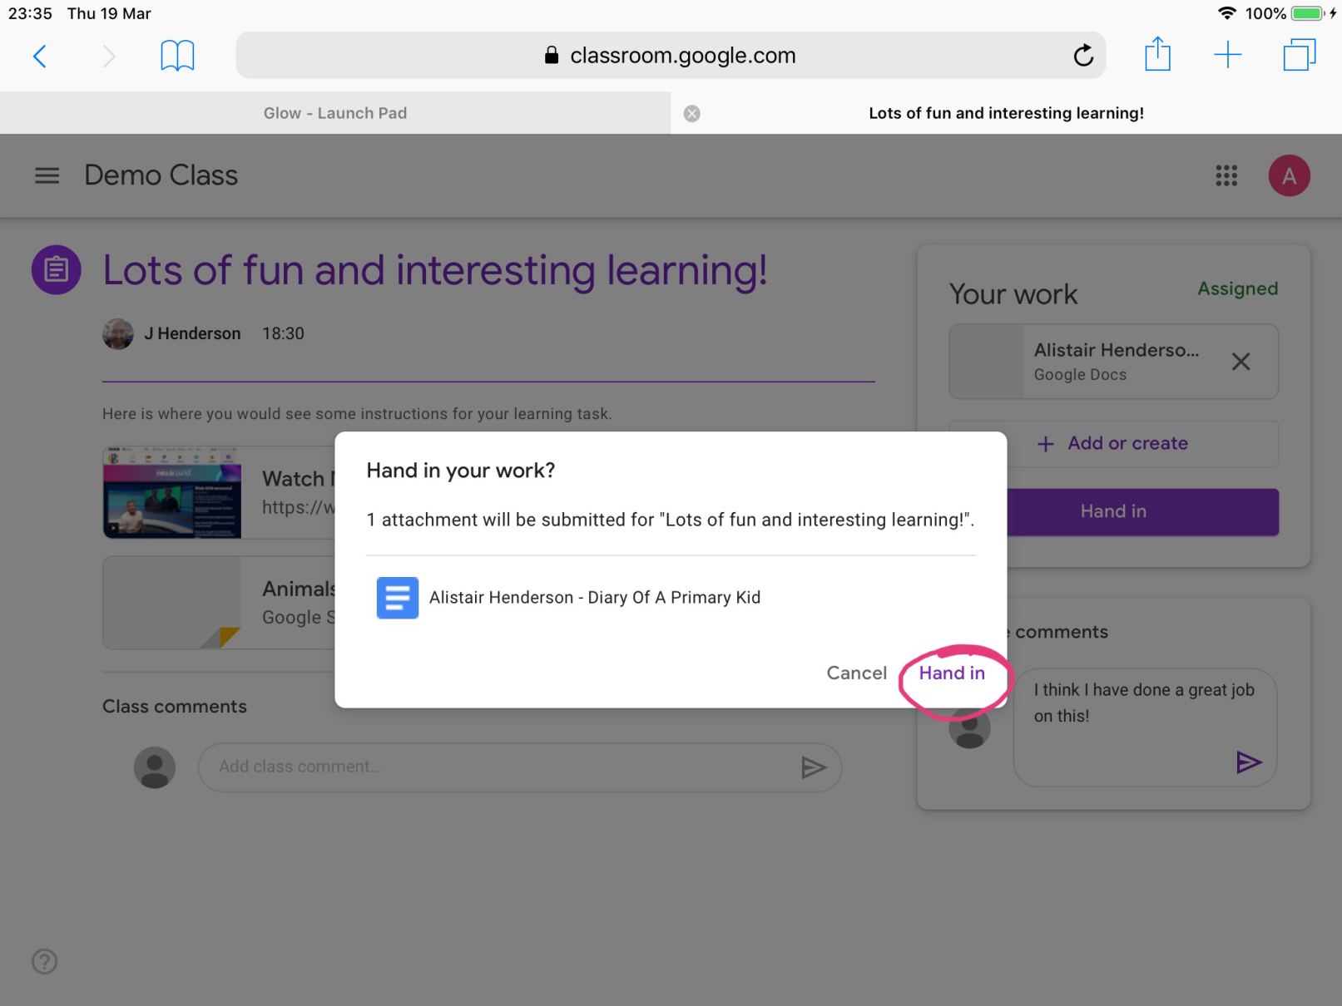
Once you hand it in, you can’t edit it any more so be sure before you confirm!

Slide 12
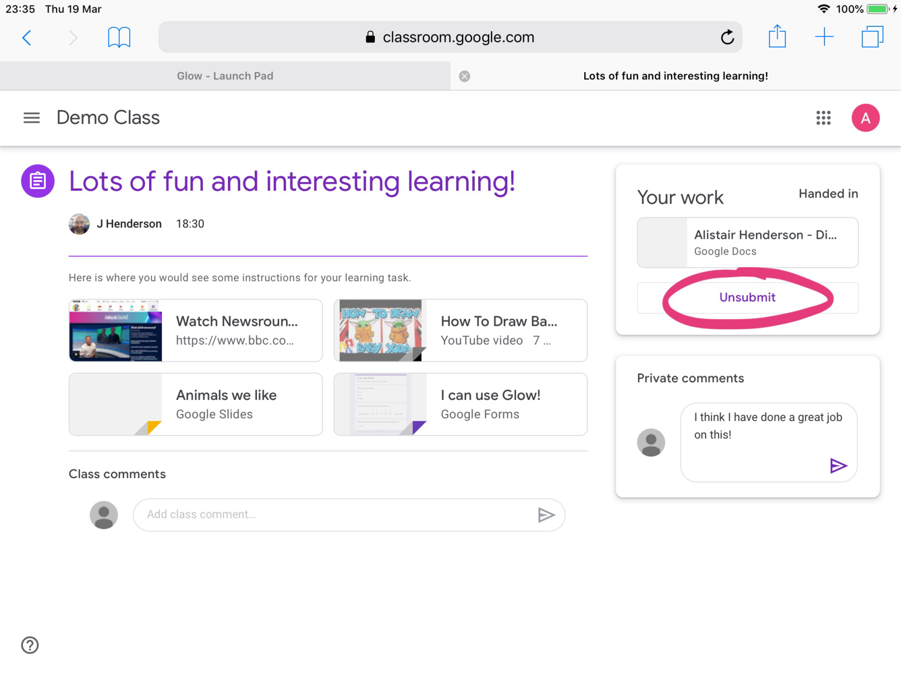
If the highlighted area now says ‘Unsubmit,’ you have successfully handed it in!

Slide 13
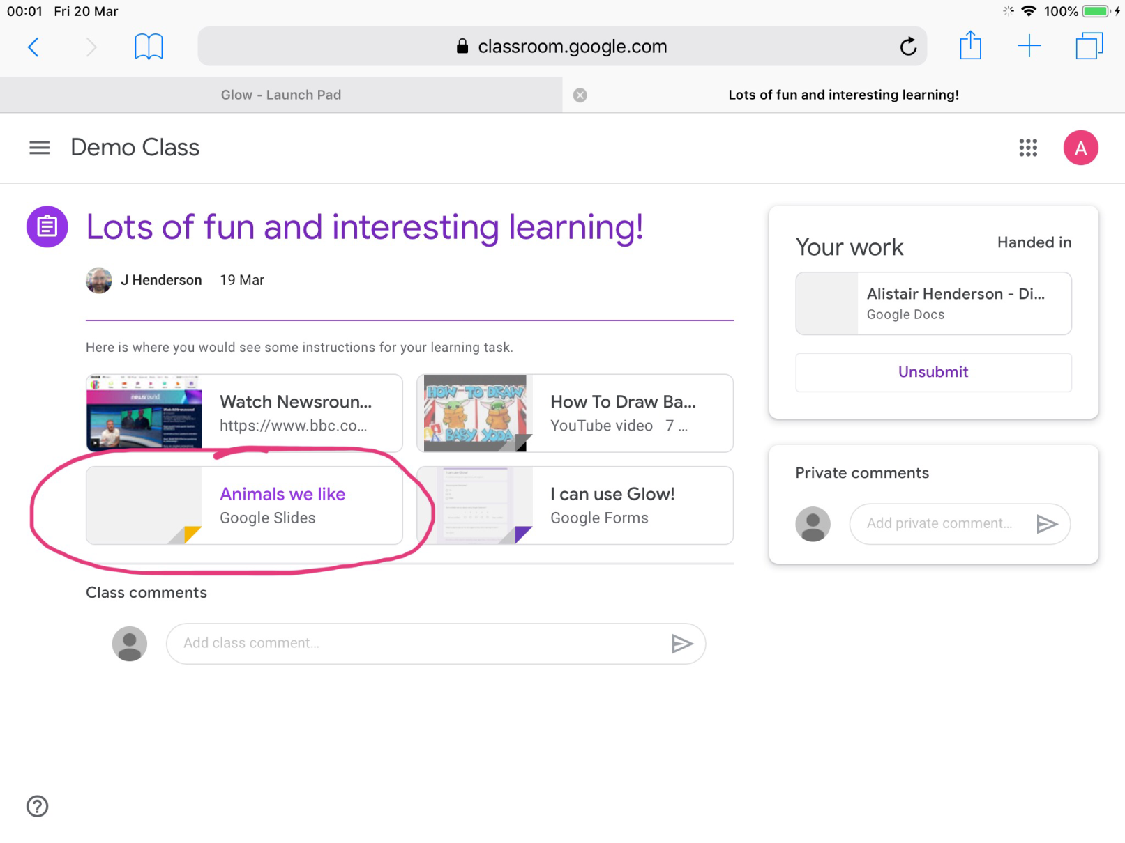
Opening a Slides file works exactly the same way as for the Docs file.
This Slides file is open to all class members to edit.

Slide 14
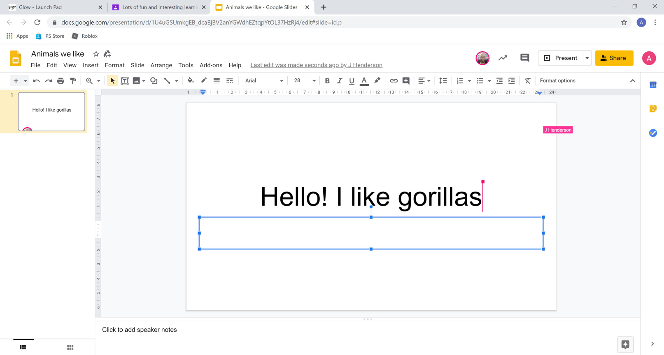
Because this particular slides is a shared document and lots of people can edit it at the same time, we can see where other users are working by coloured squares and cursors.

Slide 15
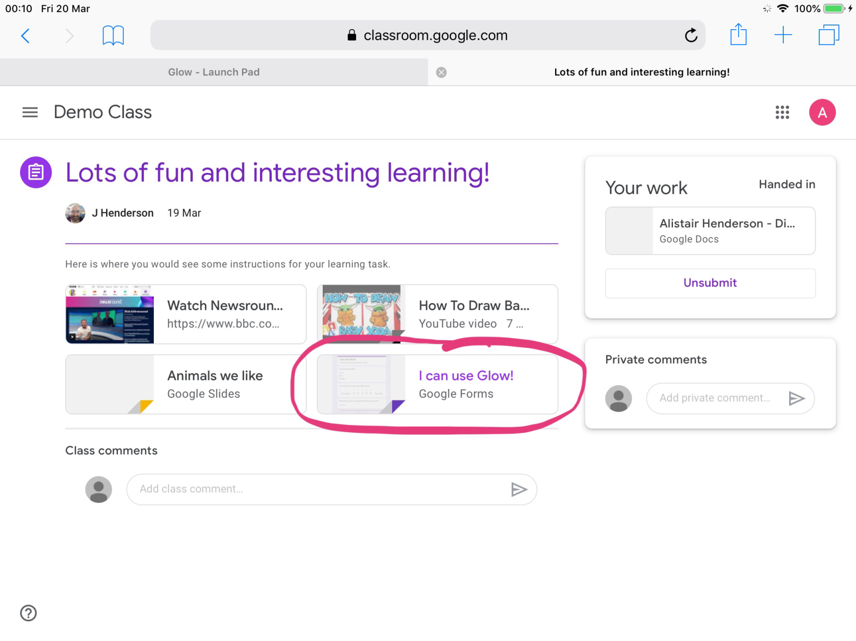
Here we can see a Forms link. These can be surveys, quizzes or a way to gather opinions.

Slide 16
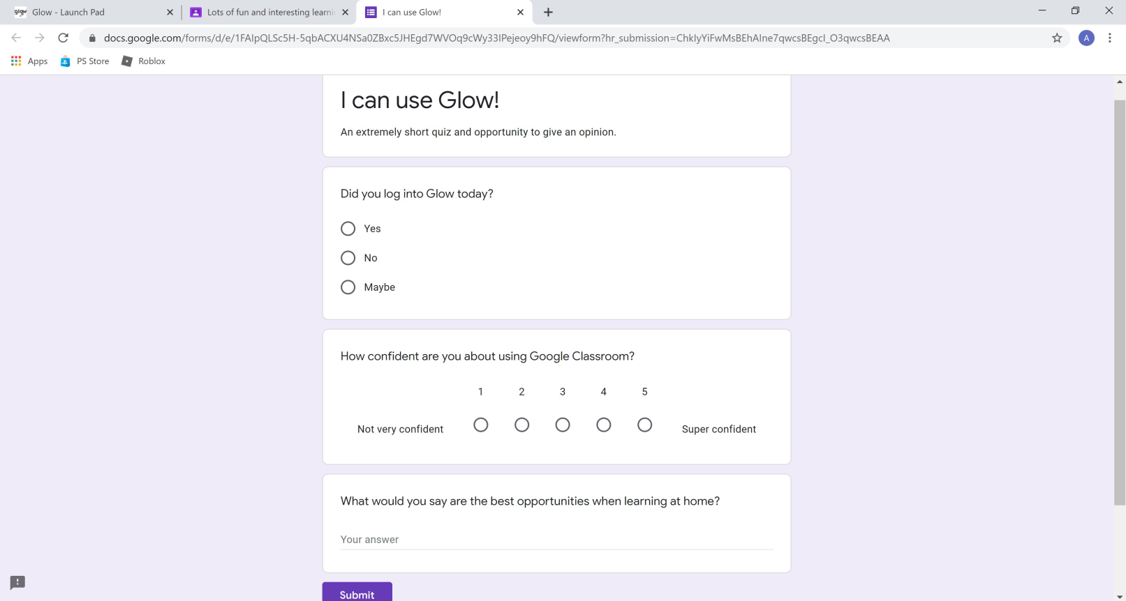
Forms open in a new tab on your browser.
When you have submitted your answers, just close the tab to go back to your Classroom.

Slide 17
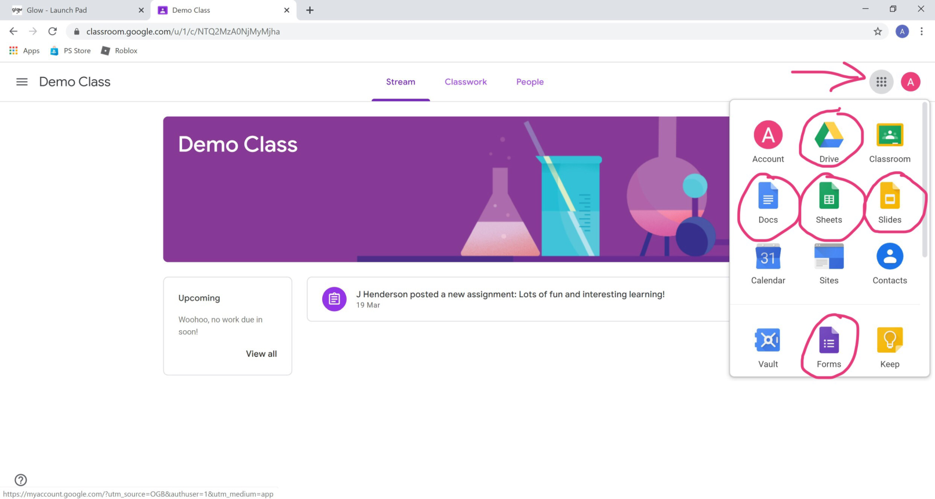
When you click on the ‘waffle’ you can see all the Google Apps you can use. The main ones are highlighted here.
You can share anything you create with your teacher and classmates using the share button shown earlier.

Slide 18
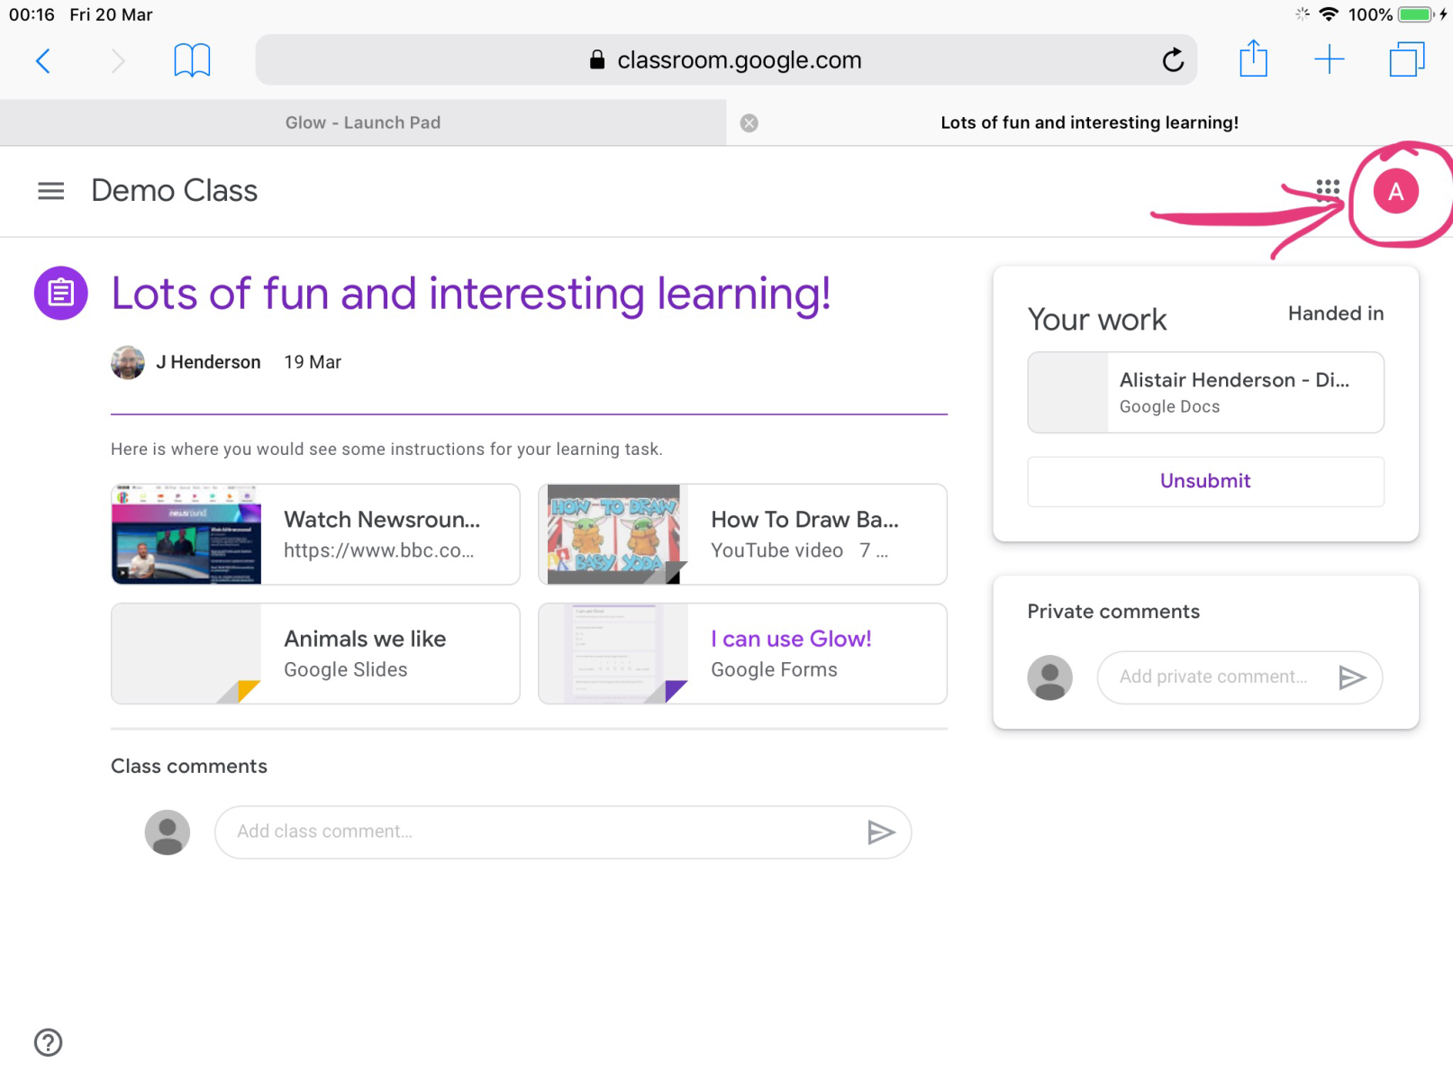
When you are finished using your Google Classroom, you must sign out properly.
Click on the round circle here. Yours will have the first letter of your name on it.

Slide 19
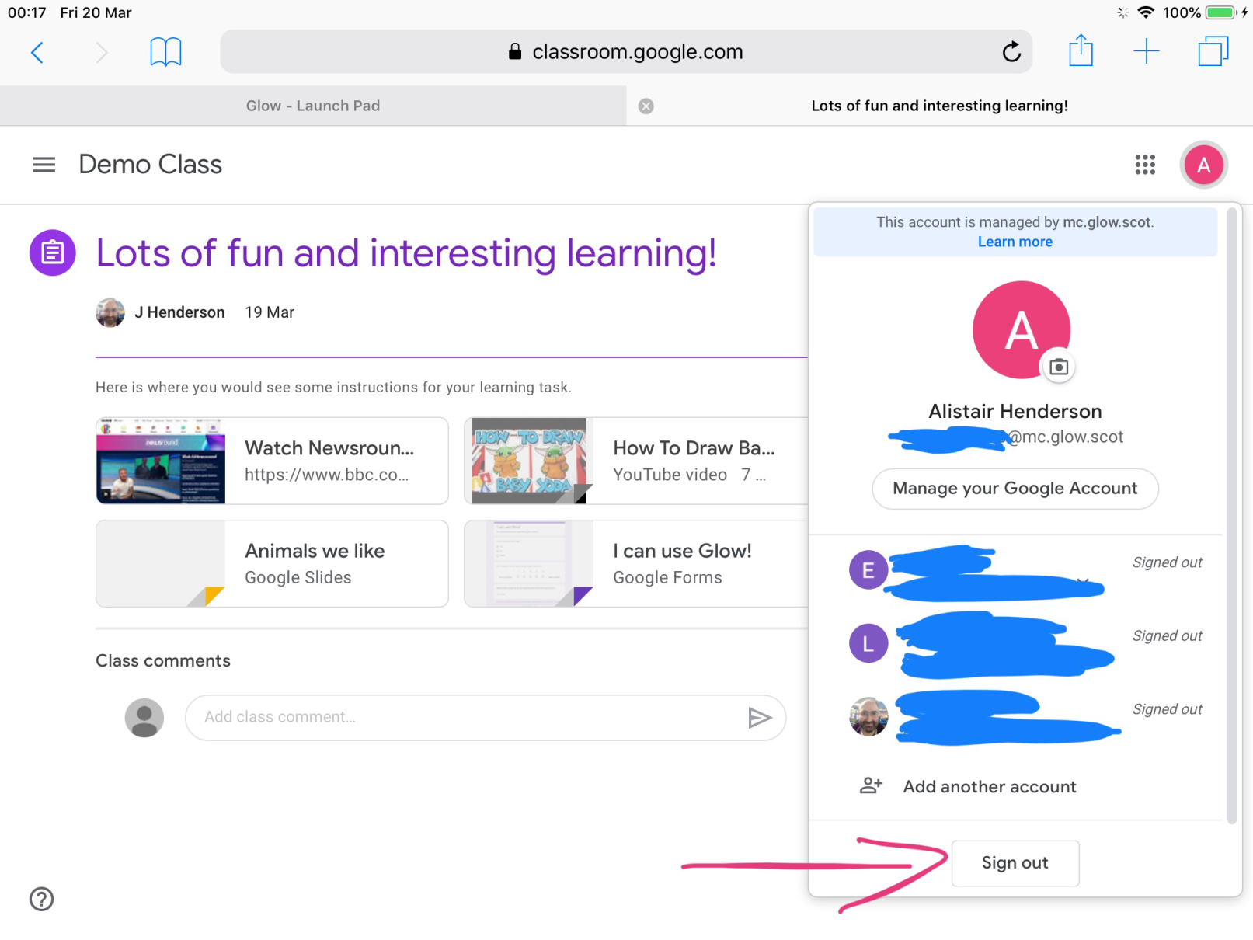
Then click here.

Slide 20
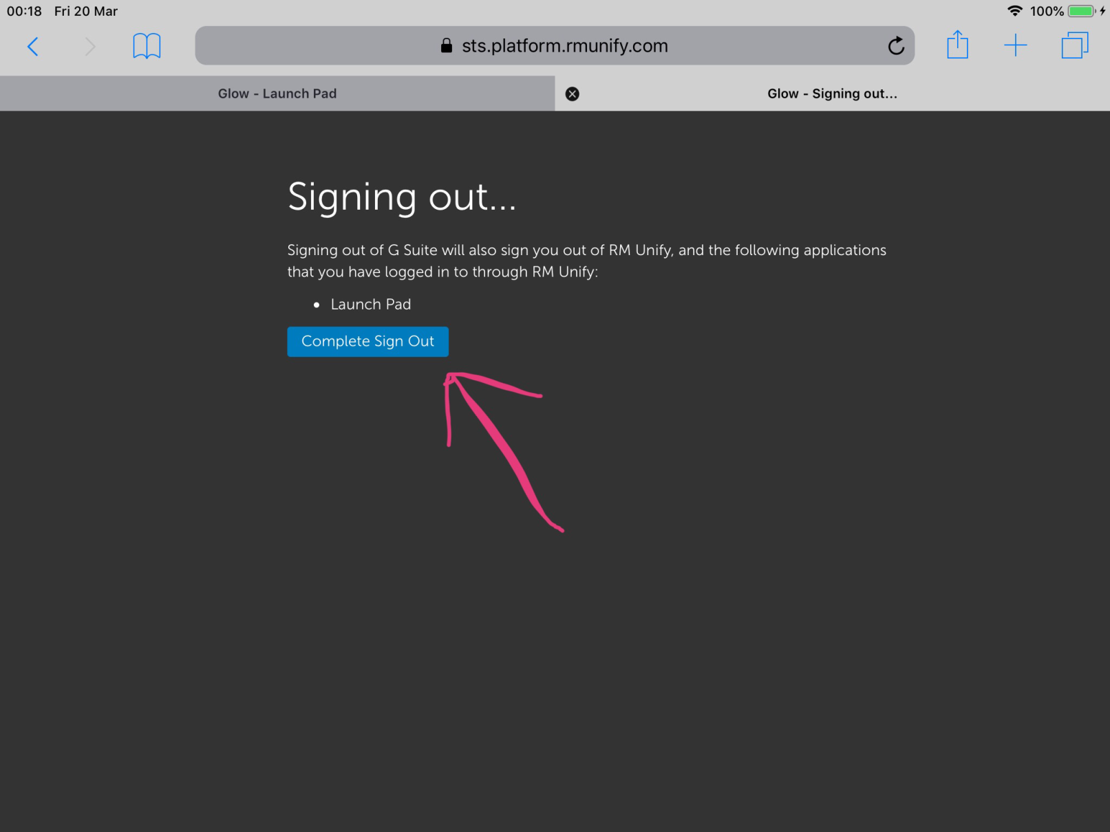
And finally click here.

Slide 21
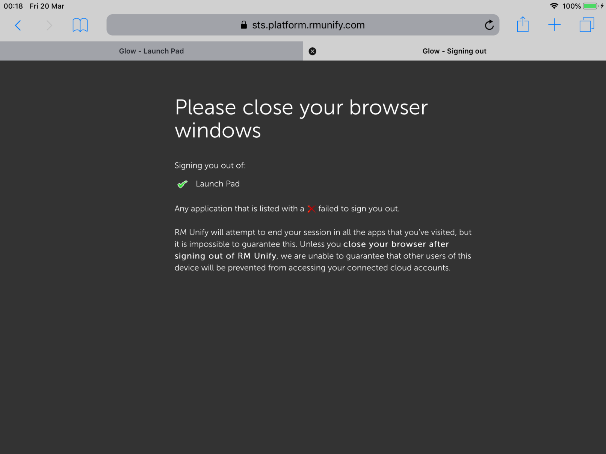
When you see this screen, close all the browser tabs you have open and close your browser.

Slide 22
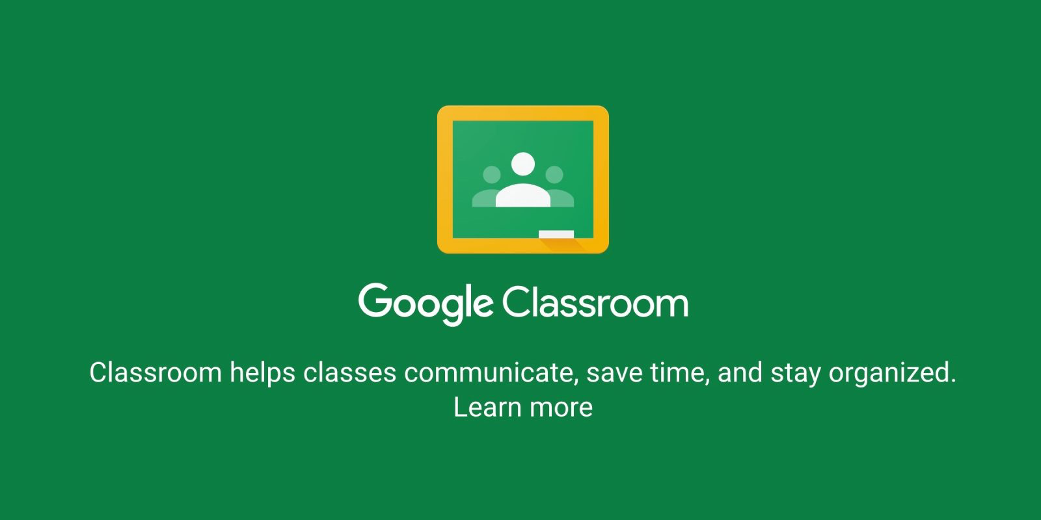
There are loads of other guides and tutorials on Google Classroom out there so if you still have questions, the answer is out there.
Also, please remember that this is new to a lot of teachers too – we’re all learning this together!

